Slide 1

Learning Russian Wordforms the SMART way
Laura A. Janda, UiT The Arctic University of Norway

Slide 2
SMARTool = Strategic Mastery of Russian Tool
The SMARTool is available at: http://uit-no.github.io/smartool/
Free web resource for L2 learners of Russian that implements findings of corpus research and a learning simulation experiment to optimize the acquisition of Russian vocabulary and morphology
Partially funded by SIU [Center for Internationalization of Education], now known as DIKU [Norwegian Agency for International Cooperation and Quality Enhancement in Higher Education], in collaboration with the National Research University Higher School of Economics in Moscow

Slide 3
Why Do We Need the SMARTool?
Memorizing paradigms was part of the traditional grammar + translation method of language teaching which is now obsolete
However today:
Paradigms are not gone from our textbooks and grammars
No systematic replacement aims at native-like mastery of morphology
Even a modest basic vocabulary of only a few thousand inflected lexemes has over a hundred thousand associated wordforms
The SMARTool can reduce the task of learning wordforms by over 90%, while also providing essential lexical and grammatical context

Slide 4
Overview
Distributional Facts about Russian Paradigms
Computational Experiment on Learning of Paradigms
Introducing the SMARTool

Slide 5
Distributional Facts about Russian Paradigms
Relatively numerous inflectional classes
Relatively large numbers of forms in paradigms
High proportion of irregularity and variation (Gen2, Loc2, new and old vocative, paradigmatic gaps, sg & pl tantum)
Distribution of wordforms is subject to Zipf’s Law

Slide 6
Zipf’s (1949) Law
Word frequency is inversely proportional to frequency rank.
Zipfian distribution:
Few words of high frequency
Sharp decline
Hapaxes account for ~50% of unique lexemes
George K. Zipf

Slide 7
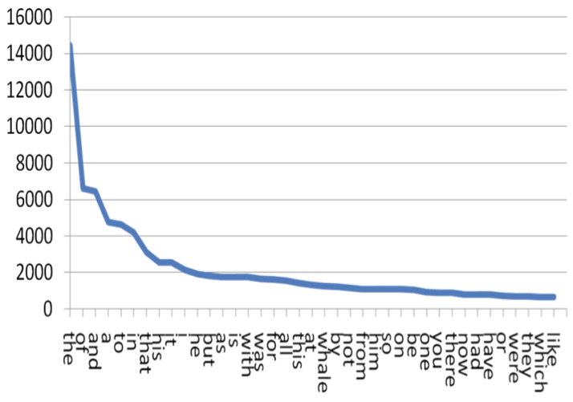
Zipf’s Law
Тhe frequency of a word is inversely proportional to its frequency rank
Zipf’s Law scales up infinitely

Slide 8
Zipf’s Law Applies to Wordforms
Language & Corpus Name | Corpus Size | Paradigm Size | Total Lexemes | Lexemes with full Paradigm | % Lexemes with full Paradigm
English Web Treebank | 254,830 | 2 | 6,369 | 1,524 | 23.92%
Norwegian Dependency Treebank | 311,277 | 4 | 12,587 | 393 | 3.12%
Russian SynTagRus | 1,032,644 | 12 | 21,945 | 13 | 0.06%
Czech Prague Dependency Treebank | 1,509,242 | 14 | 17,904 | 3 | 0.02%
Estonian ArborEst | 234,351 | 28 | 14,075 | 0 | 0%

Slide 9
Zipf’s Law Applies to Wordforms
Language & Corpus Name | Corpus Size | Paradigm Size | Total Lexemes | Lexemes with full Paradigm | % Lexemes with full Paradigm
English Web Treebank | 254,830 | 2 | 6,369 | 1,524 | 23.92%
Norwegian Dependency Treebank | 311,277 | 4 | 12,587 | 393 | 3.12%
Russian SynTagRus | 1,032,644 | 12 | 21,945 | 13 | 0.06%
Czech Prague Dependency Treebank | 1,509,242 | 14 | 17,904 | 3 | 0.02%
Estonian ArborEst | 234,351 | 28 | 14,075 | 0 | 0%
Because Zipf’s Law scales up, these numbers will never change substantially, no matter how large the corpus is

Slide 10
Language Exposure as a Big Corpus
A large corpus is a close approximation to the lifetime linguistic input for a native speaker, estimated at about 5-10 million words per year
Zipfian distributions remain the same even for very large corpora, like those that approximate a speaker’s exposure to their native language
A native speaker of Russian encounters all twelve paradigm forms of less than 0.1% of nouns that they are exposed to in a lifetime
The portion of adjectives and verbs attested in all paradigm forms is virtually zero.

Slide 11
Paradigm Cell Filling Problem (Ackerman et al. 2009)
Native speakers of languages with complex inflectional morphology routinely recognize and produce forms that they have never encountered.
Q: How is this possible?
A: Inflectional morphology is mastered through exposure to partially overlapping subsets of paradigms arranged according to Zipf’s Law

Slide 12
Paradigm Cell Filling Problem (Ackerman et al. 2009)
Native speakers of languages with complex inflectional morphology routinely recognize and produce forms that they have never encountered.
Q: How is this possible?
A: Inflectional morphology is mastered through exposure to partially overlapping subsets of paradigms arranged according to Zipf’s Law
This also explains
why native speakers have the intuition that full paradigms exist

Slide 13
Illustration of Overlapping Subsets of Paradigms
Sample of wordforms of 982 noun lexemes
All lexemes with frequency ≥ 50 in SynTagRus representing five paradigm types:
masculine inanimate (312 lexemes)
masculine animate (95 lexemes)
neuter inanimate (238 lexemes)
feminine inanimate II (ending in -a/-я, 261 lexemes)
feminine inanimate III (ending in -ь, 75 lexemes)

Slide 14
Illustration of Overlapping Subsets of Paradigms
Sample of wordforms of 982 noun lexemes
All lexemes with frequency ≥ 50 in SynTagRus representing five paradigm types:
masculine inanimate (312 lexemes)
masculine animate (95 lexemes)
neuter inanimate (238 lexemes)
feminine inanimate II (ending in -a/-я, 261 lexemes)
feminine inanimate III (ending in -ь, 75 lexemes)
Next we look at the grammatical profiles (frequency distributions)
of wordforms

Slide 15
Grammatical Profiles of Some High-frequency Russian Nouns
‘fear’ ‘soldier’ ‘department’ ‘concept’ ‘memory’
Nsg | страх | солдат | отделение | концепция | память
Gsg | страха | солдата | отделения | концепции | памяти
Dsg | страху | солдату | отделению | концепции | памяти
Asg | страх | солдата | отделение | концепцию | память
Isg | страхом | солдатом | отделением | концепцией | памятью
Lsg | страхе |  | отделении | концепции | памяти
Npl | страхи | солдаты | отделения
Gpl | страхов | солдат | отделений | концепций
Dpl |  | солдатам
Apl | страхи | солдат | отделения | концепции
Ipl | страхами |  | отделениями | концепциями
Lpl | страхах | солдатах | отделениях
Key: bold >20%, plain >10%, grey 1-9%, (blank) unattested

Slide 16
Grammatical Profiles of Other High-Frequency Russian Nouns
‘background’ ‘champion’ ‘extent’ ‘frame’ ‘difficulty’
Nsg | фон | чемпион |  |  | трудность
Gsg | фона | чемпиона |  |  | трудности
Dsg |  | чемпиону |  |  | трудности
Asg |  | чемпионa |  |  | трудность
Isg |  | чемпионом |  |  | трудностью
Lsg | фоне |  | протяжении
Npl |  | чемпионы |  | рамки | трудности
Gpl |  | чемпионов |  | рамок | трудностей
Dpl |  | чемпионам
Apl |  | чемпионов |  | рамки | трудности
Ipl |  | чемпионами |  | рамками | трудностями
Lpl |  |  |  | рамках | трудностях
Key: bold >20%, plain >10%, grey 1-9%, (blank) unattested

Slide 17
Masculine animates

Slide 18
Typically a lexeme is found in only 1-3 wordforms
Masculine animates

Slide 19
Typically a lexeme is found in only 1-3 wordforms
The typical wordforms
are motivated by constructions
Masculine animates

Slide 20
NomPl аналитики отмечают
‘analysts make the point that’
Typically a lexeme is found in only 1-3 wordforms
The typical wordforms
are motivated by constructions
InsSg стать/быть чемпионом
‘become/be the champion’
Masculine animates

Slide 21
Any single lexeme gives exposure to only a subset of the paradigm.
Each lexeme has a different subset of most typical forms.
Collectively they populate the entire “space” of case/number combinations.
Masculine animates

Slide 22
Distributional Facts about Russian Paradigms: Summary
Even a small vocabulary can have >100,000 wordforms
<10% of wordforms are frequent, others rare or unencountered
Each lexeme is common in a subset of wordforms
The wordforms common to a lexeme are motivated by typical collocations and grammatical constructions
Overlapping subsets of wordforms create the illusion of a full paradigm, make it possible for native speakers to comprehend and produce wordforms they have never encountered

Slide 23
Computational Leaning Experiment
Based on an ordered list of the most frequent forms for nouns, verbs, and adjectives in SynTagRus
Machine learning:
Given the 100 most frequent forms, predict the next 100 most frequent forms
Given the 200 most frequent forms, predict the next 100 most frequent forms
Given the 300 most frequent forms, predict the next 100 most frequent forms
Given the 400 most frequent forms, predict the next 100 most frequent forms
Given the 500 most frequent forms, predict the next 100 most frequent forms
… until 5400, when SynTagRus runs out of data

Slide 24
Computational Leaning Experiment
This is the training data
Based on an ordered list of the most frequent forms for nouns, verbs, and adjectives in SynTagRus
Machine learning:
Given the 100 most frequent forms, predict the next 100 most frequent forms
Given the 200 most frequent forms, predict the next 100 most frequent forms
Given the 300 most frequent forms, predict the next 100 most frequent forms
Given the 400 most frequent forms, predict the next 100 most frequent forms
Given the 500 most frequent forms, predict the next 100 most frequent forms
… until 5400, when SynTagRus runs out of data

Slide 25
Computational Leaning Experiment
This is the testing data
Based on an ordered list of the most frequent forms for nouns, verbs, and adjectives in SynTagRus
Machine learning:
Given the 100 most frequent forms, predict the next 100 most frequent forms
Given the 200 most frequent forms, predict the next 100 most frequent forms
Given the 300 most frequent forms, predict the next 100 most frequent forms
Given the 400 most frequent forms, predict the next 100 most frequent forms
Given the 500 most frequent forms, predict the next 100 most frequent forms
… until 5400, when SynTagRus runs out of data

Slide 26
Data for training and testing from SynTagRus
Frequency & Form | Lemma | POS | Parse of form
1447 может | мочь | VERB | Aspect=Imp|Mood=Ind|Number=Sing|Person=3|Tense=Pres|VerbForm=Fin|Voice=Act
1286 года | год | NOUN | Animacy=Inan|Case=Gen|Gender=Masc|Number=Sing
999 лет | год | NOUN | Animacy=Inan|Case=Gen|Gender=Masc|Number=Plur
832 году | год | NOUN | Animacy=Inan|Case=Loc|Gender=Masc|Number=Sing
813 время | время | NOUN | Animacy=Inan|Case=Acc|Gender=Neut|Number=Sing
678 россии | россия | NOUN | Animacy=Inan|Case=Gen|Gender=Fem|Number=Sing
571 могут | мочь | VERB | Aspect=Imp|Mood=Ind|Number=Plur|Person=3|Tense=Pres|VerbForm=Fin|Voice=Act
571 люди | человек | NOUN | Animacy=Anim|Case=Nom|Gender=Masc|Number=Plur
543 россии | россия | NOUN | Animacy=Inan|Case=Loc|Gender=Fem|Number=Sing
436 является | являться | VERB | Aspect=Imp|Mood=Ind|Number=Sing|Person=3|Tense=Pres|VerbForm=Fin|Voice=Act
416 случае | случай | NOUN | Animacy=Inan|Case=Loc|Gender=Masc|Number=Sing
411 людей | человек | NOUN | Animacy=Anim|Case=Gen|Gender=Masc|Number=Plur
403 страны | страна | NOUN | Animacy=Inan|Case=Gen|Gender=Fem|Number=Sing
400 жизни | жизнь | NOUN | Animacy=Inan|Case=Gen|Gender=Fem|Number=Sing

Slide 27
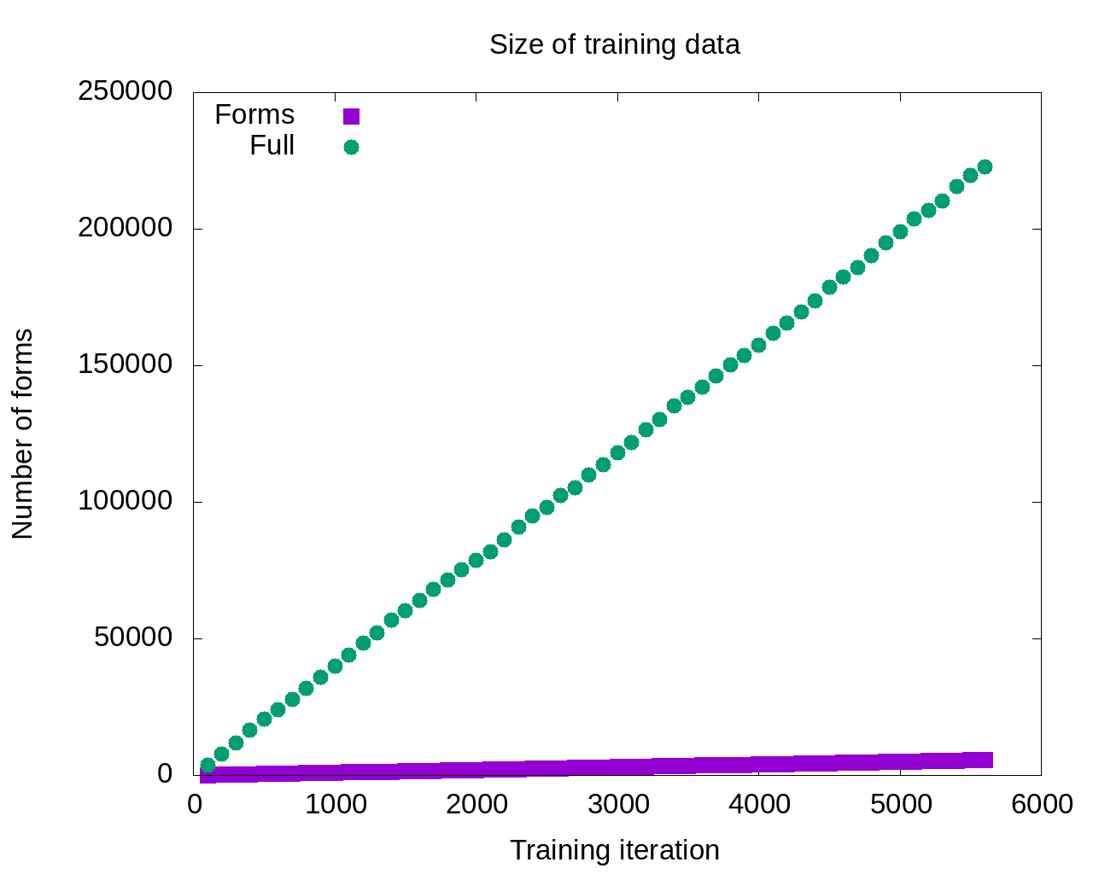

Slide 28
So the model that gets the most input should be the most successful, right?

Slide 29
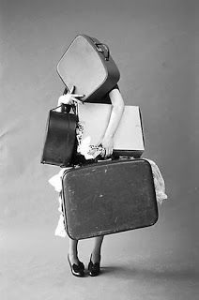
Maybe not…
So the model that gets the most input should be the most successful, right?

Slide 30
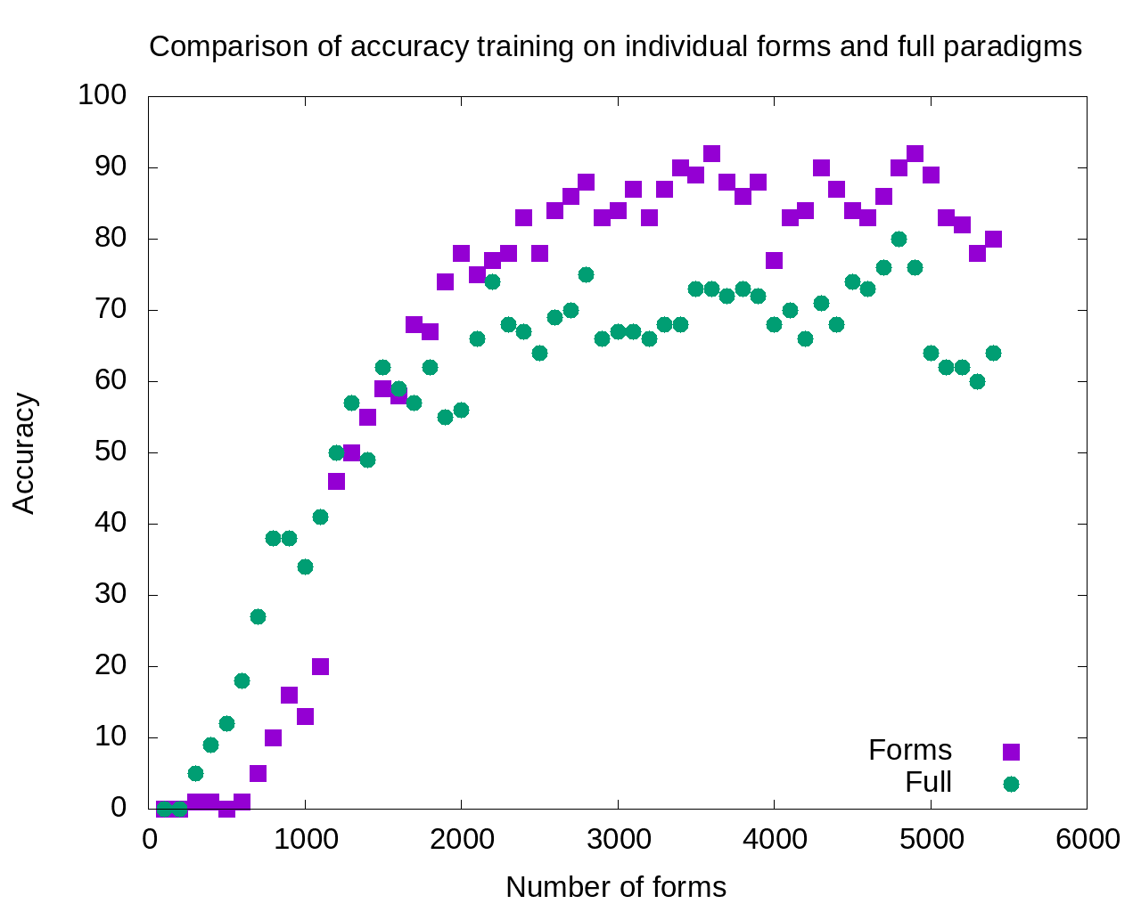

Slide 31
1800-5400:
Single forms model outperforms
full paradigms

Slide 32
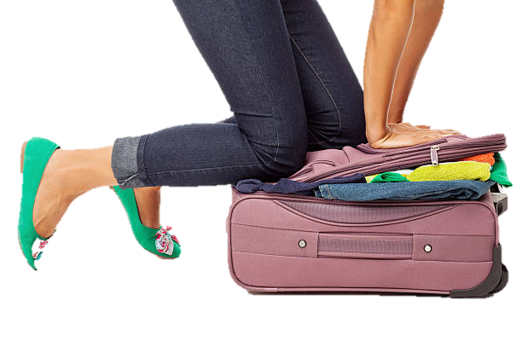
Excess data is probably overpopulating the search domain

Slide 33
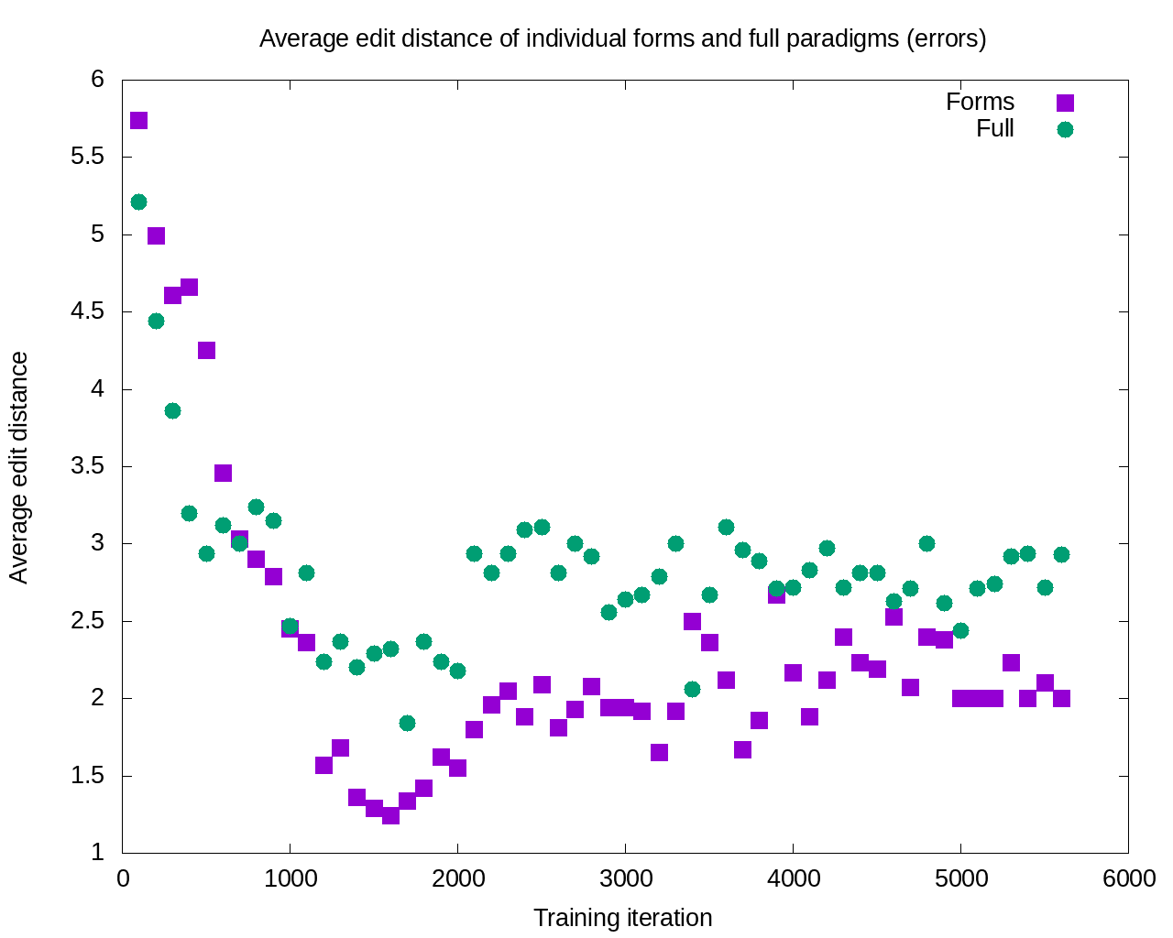

Slide 34
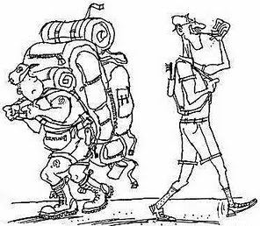
After 11 iterations, the errors committed by the single forms model are consistently smaller

Slide 35
Computational Learning Experiment: Summary
Learning is potentially enhanced by focus only on the most typical wordforms attested for each lexeme: accuracy increases and severity of errors decreases
This finding is consistent with a usage-based cognitively plausible model

Slide 36
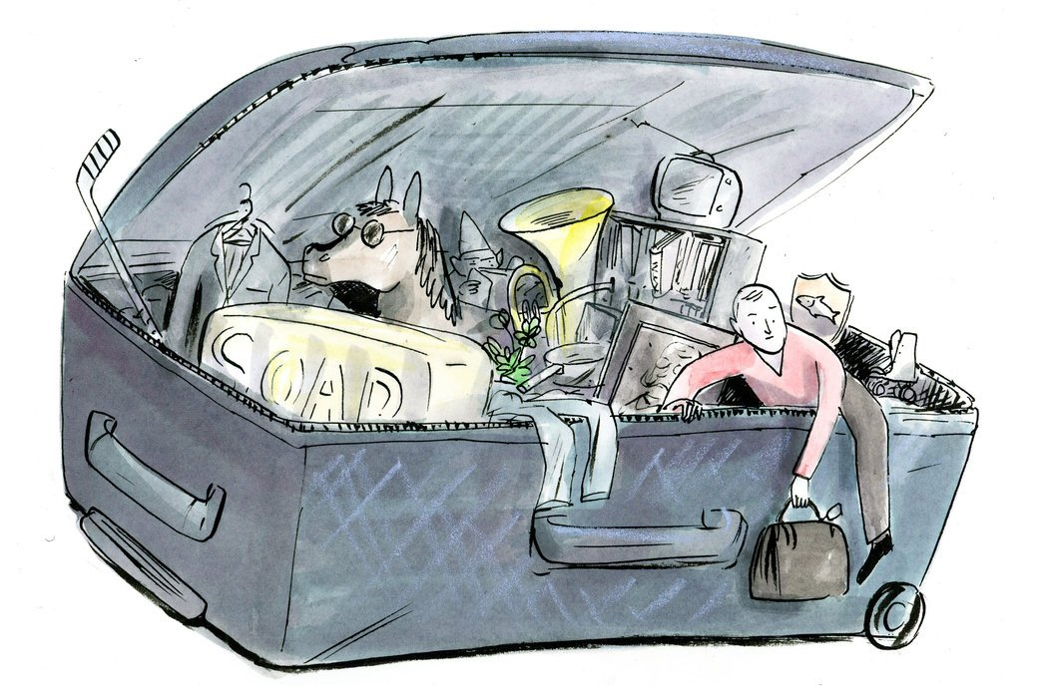
How Can We Escape From Overstuffed Paradigms?
Textbooks have always focused on certain forms and constructions
Now we can do this in a scientific, consistent way

Slide 37

Introducing the SMARTool
Strategic Mastery of Russian Tool
The user can browse over 3000 Russian words according to proficiency level, topic, and grammatical categories.
For each word, the SMARTool provides the three most common forms, plus example sentences that show typical collocations and grammatical constructions.
The SMARTool provides audio and translations

Slide 38
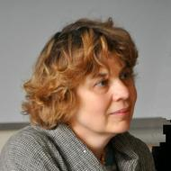
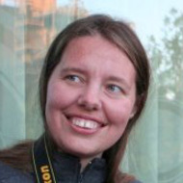
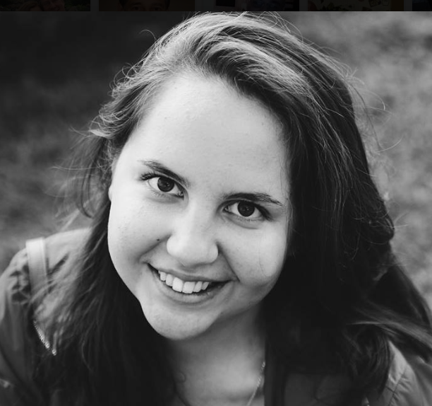
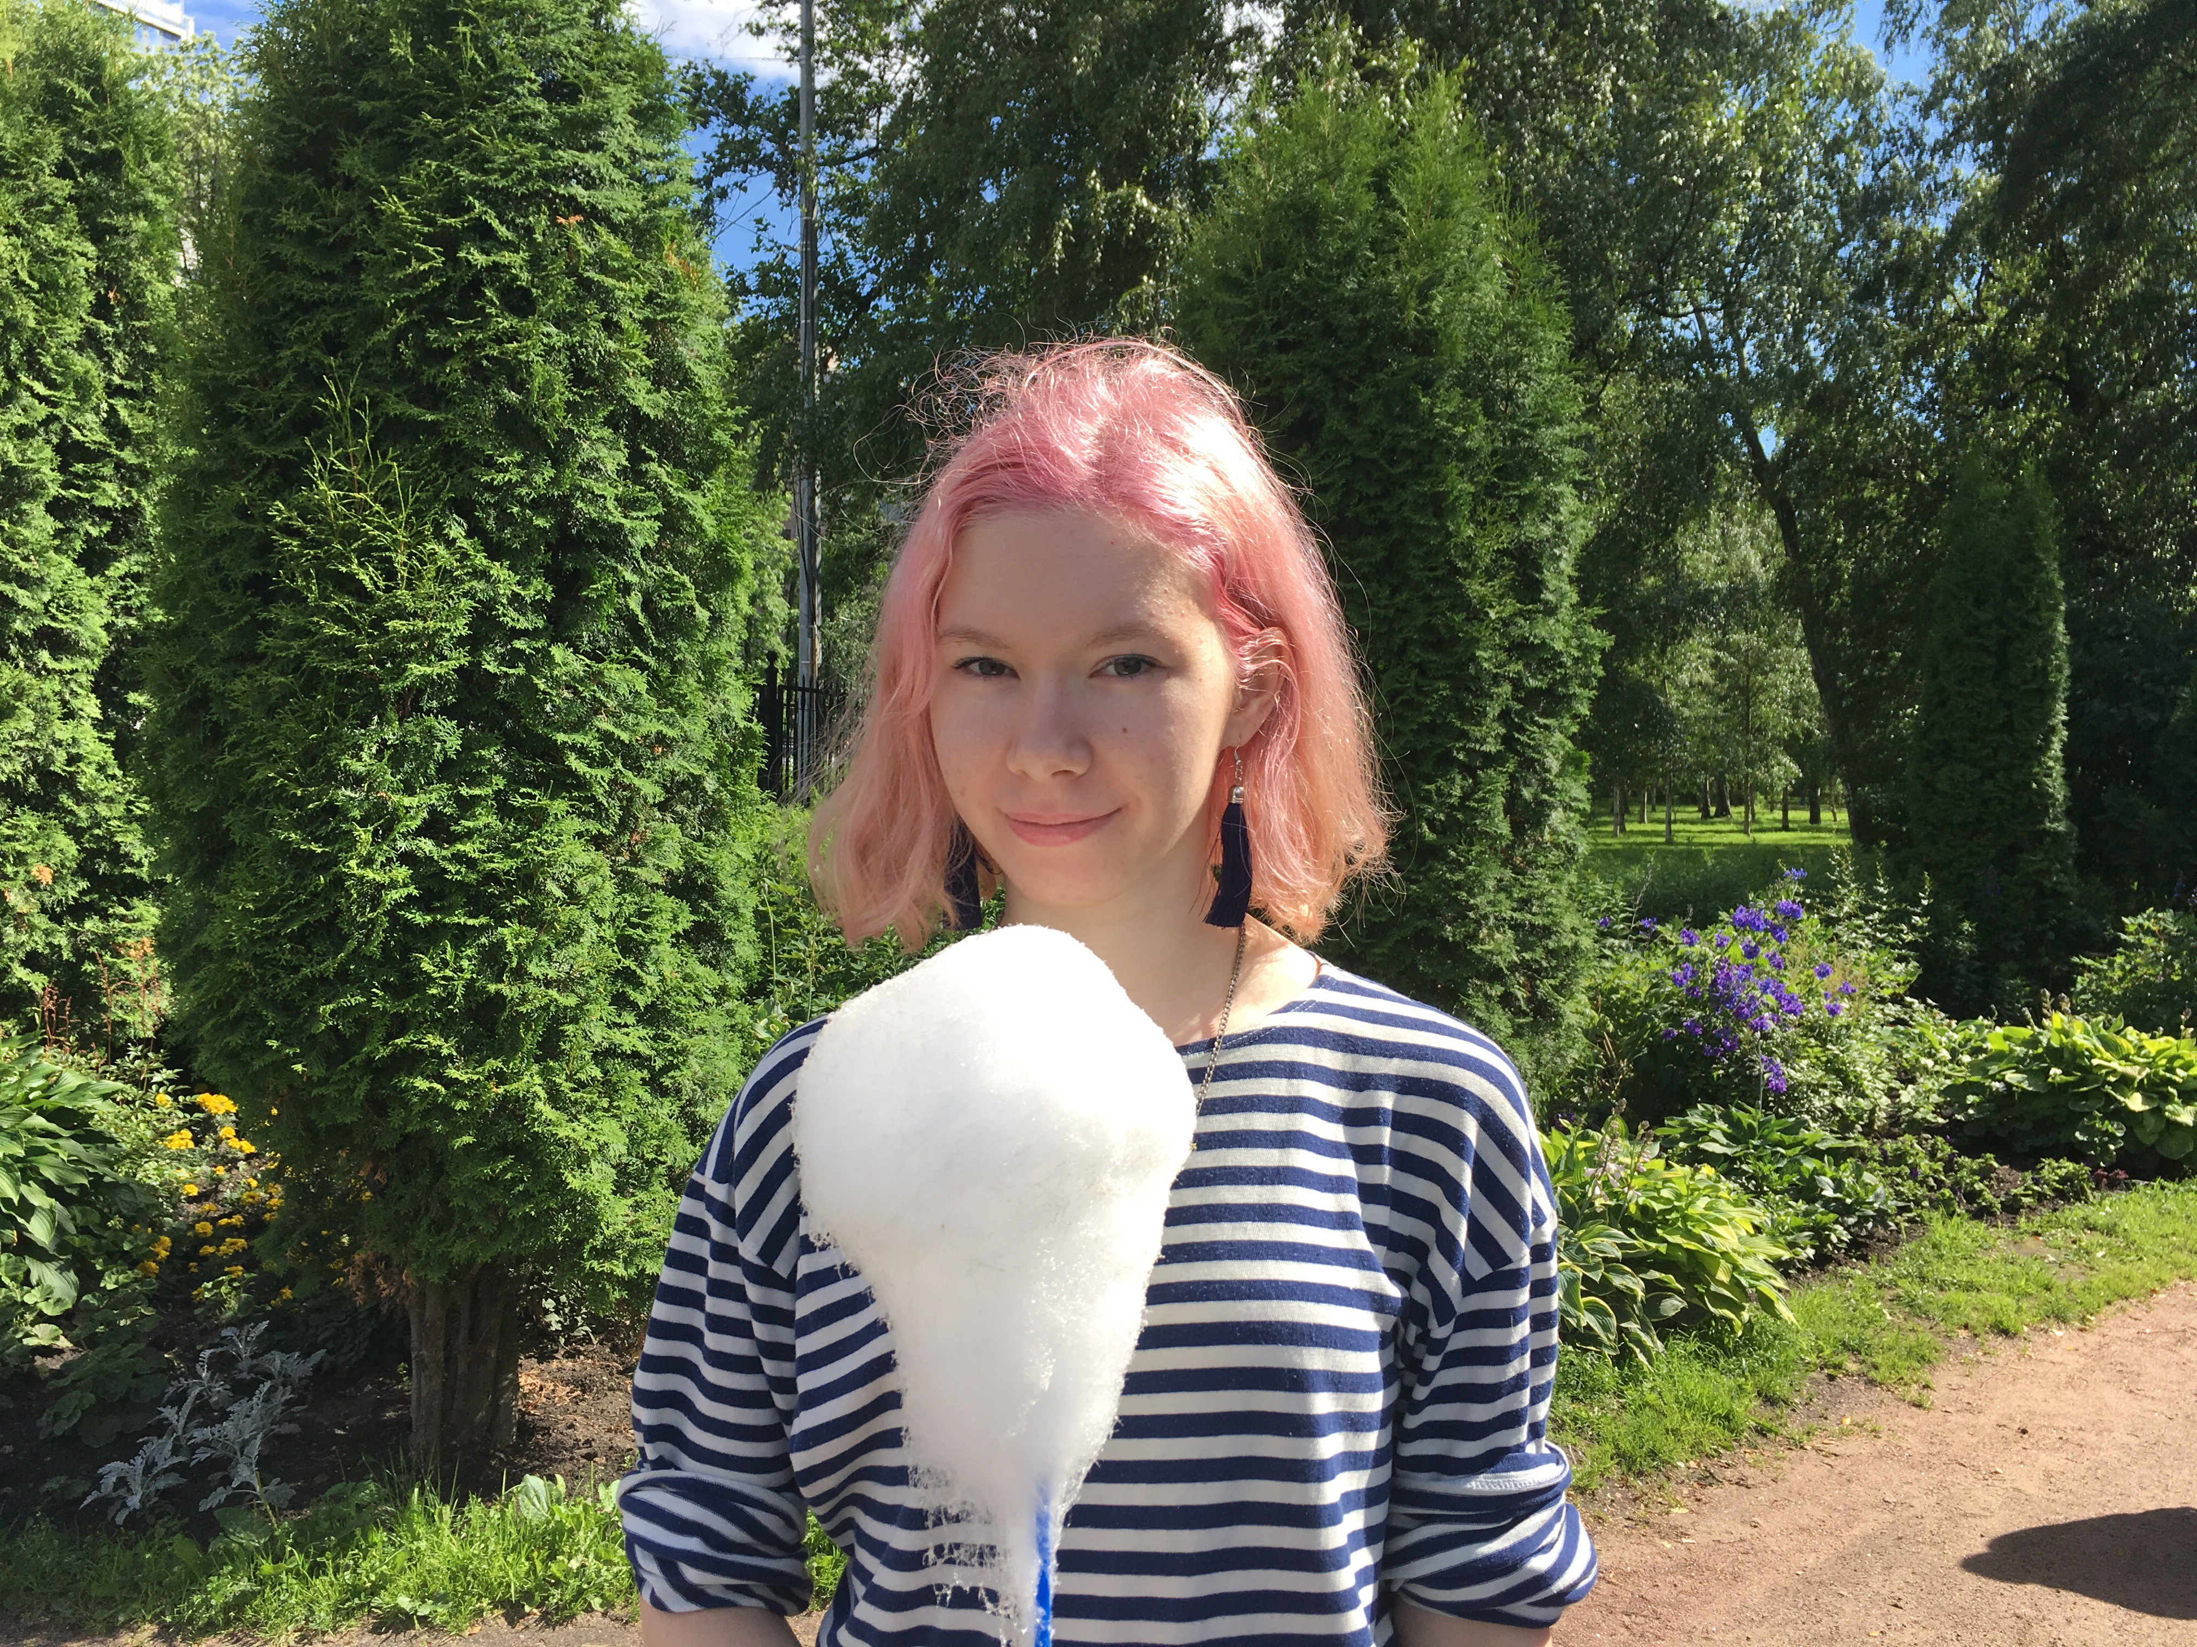
Members of the SMARTool team
Radovan Bast
Tore Nesset
Svetlana Sokolova
Mikhail Kopotev
Francis Tyers
Ekaterina Rakhilina
Olga Lyashevskaya
Valentina Zhukova
James McDonald
Evgeniia Sudarikova

Slide 39
Vocabulary Selection from 5 Textbooks and Лексический минимум; Balanced for Nouns, Verbs, Adjs (RNC ratio)
CEFR Level | ACTFL Equivalent | Russian Equivalent | SMARTool number of lexemes
A1 “Beginner” | Novice Low-Mid | ТЭУ Элементарный уровень | 500
A2 “Elementary” | Novice High | ТБУ Базовый уровень | 500
B1 “Intermediate” | Intermediate Low-Mid | ТРКИ-1 I Cертификационный уровень | 1,000
B2 “Upper Intermediate” | Intermediate High-Advanced Low | ТРКИ-2 | 1,000

Slide 40
Identification of High Frequency Wordforms
SynTagRus: the only substantial corpus of Russian that has 100% manually corrected disambiguation, a “gold standard” corpus
SynTagRus used to determine frequency distributions of wordforms, also known as “grammatical profiles”
For each lexeme, we select the three most common wordforms
For example, for бизнесмен ‘businessman’: GenPl бизнесменов, NomPl бизнесмены, NomSg бизнесмен
If over 90% of attestations are only two forms or only one form, then only those forms are selected
For example, for сентябрь ‘September’: GenSg сентября, LocSg сентябре
For example, for балерина ‘ballerina’: InsSg балериной

Slide 41
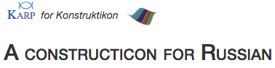
Identification of Typical Contexts
For each wordform we determine what grammatical constructions and lexical collocations are most typical
This is done by querying:
the Russian National Corpus (http://ruscorpora.ru)
the Collocations Colligations Corpora (http://cococo.cosyco.ru/)
the Russian Constructicon (https://spraakbanken.gu.se/karp/#?mode=konstruktikon-rus)

Slide 42
Corpus-inspired Example Sentences
Illustrate typical grammatical constructions and lexical collocations
Examples are adjusted to proficiency levels
Translations and audio available
Новый закон защищает интересы бизнесменов.
Бизнесмен должен быть честным.
Российские бизнесмены протестуют против повышения налогов.
Первого сентября начинается учебный год.
В сентябре начинают опадать листья.
Анна Павлова с детства мечтала стать балериной.

Slide 43
SMARTool Filters
Select a level: A1, A2, B1, B2, all levels
Search by topic: внутренний мир, время, еда, животные/растения, жильё, здоровье, люди, магазин, мера, общение, одежда, описание, погода, политика, путешествие, свободное время, транспорт, учёба/работа
Search by analysis: Select grammatical features, such as “Ins.Sing”
Search by dictionary

Slide 44
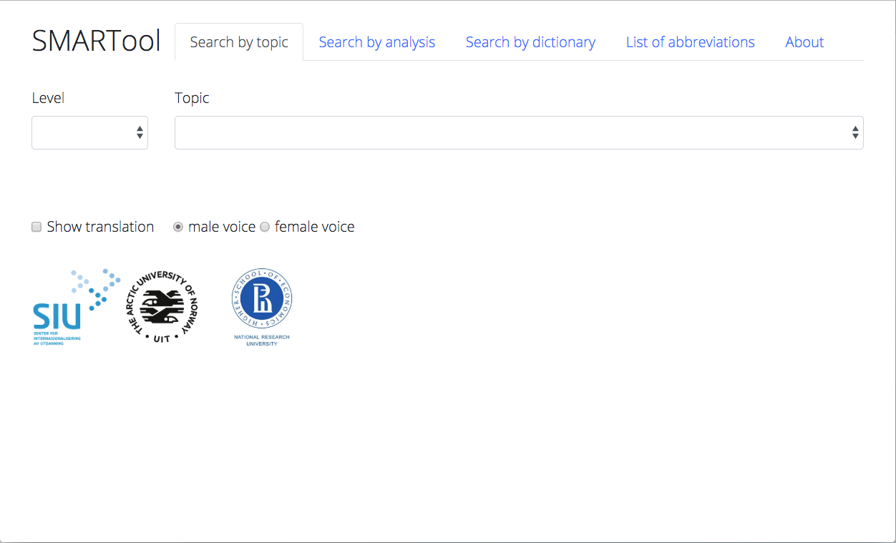
Select a Level
2) Search by topic, analysis, dictionary

Slide 45
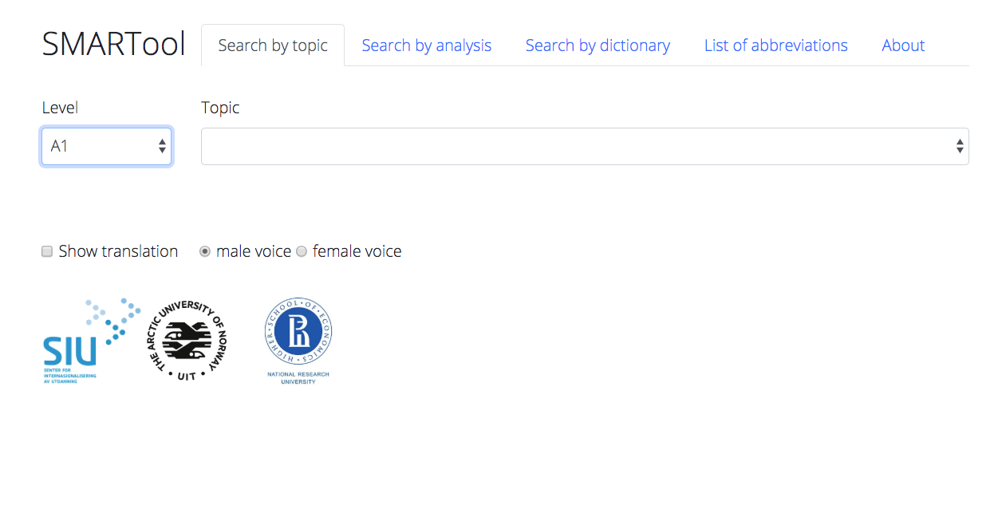

Slide 46
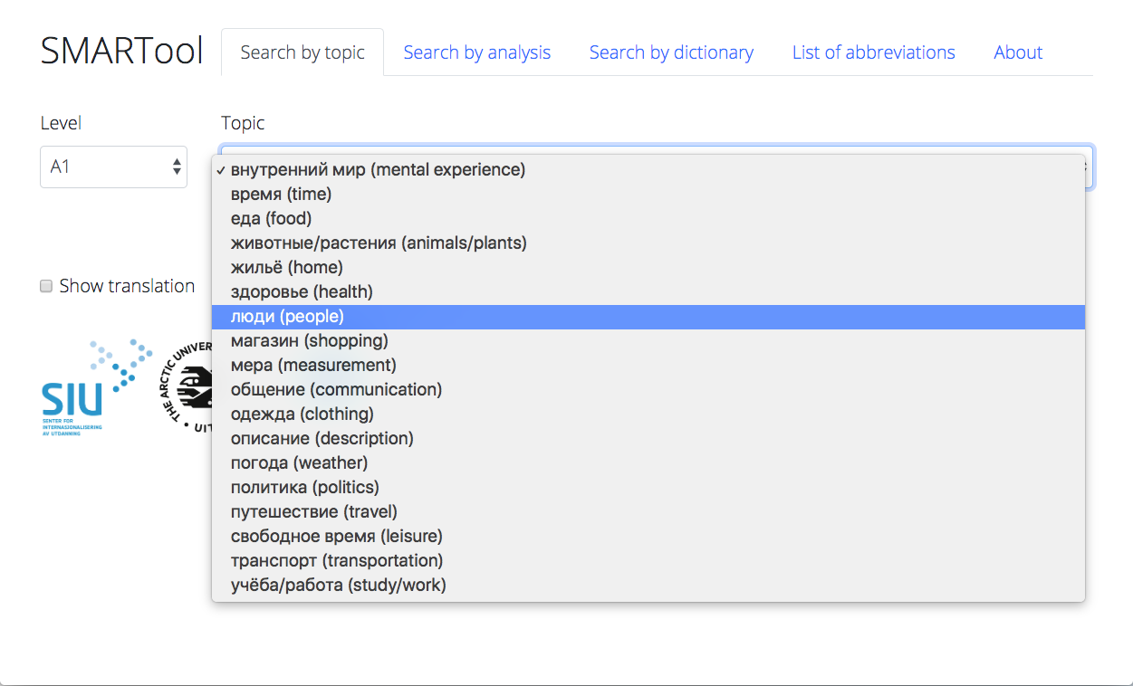

Slide 47
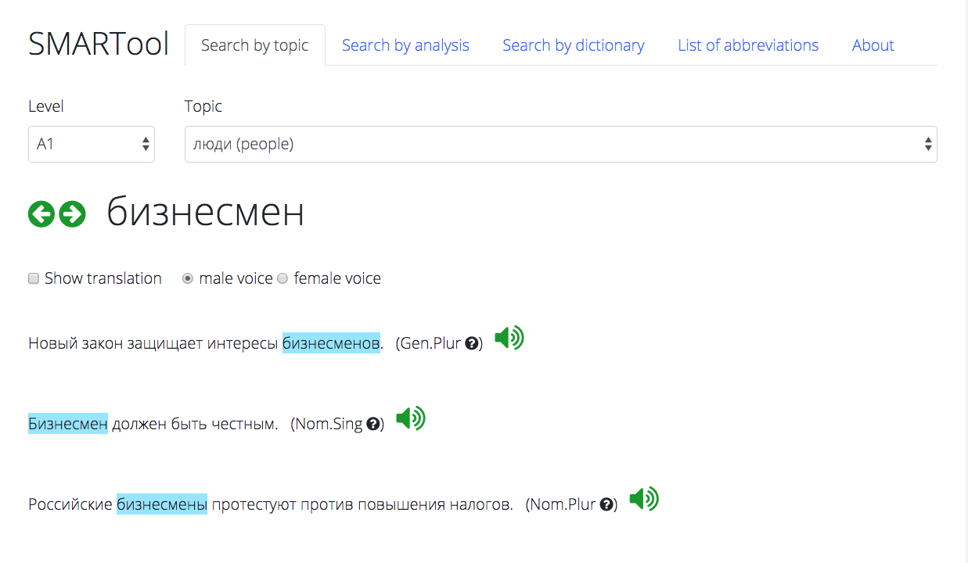

Slide 48
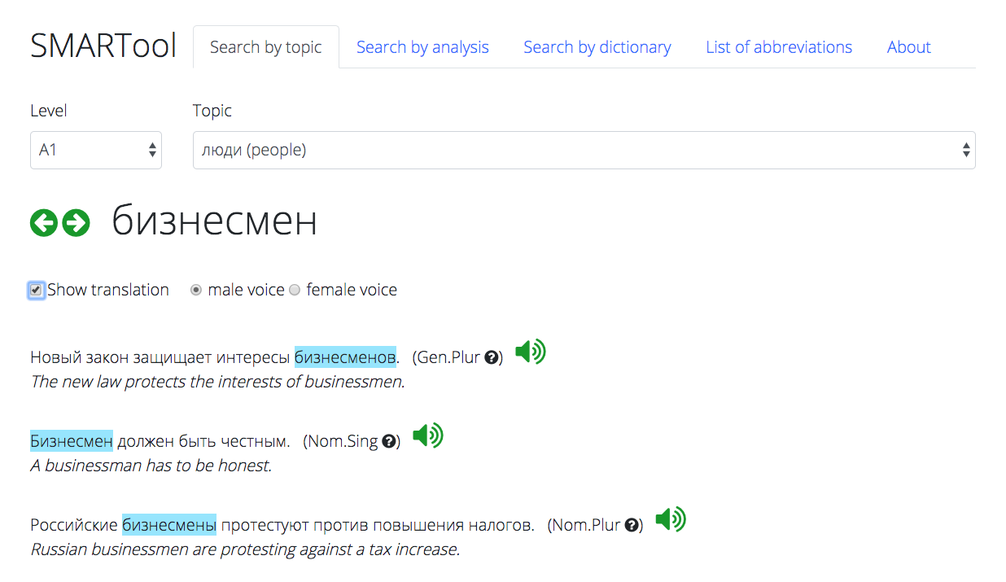

Slide 49
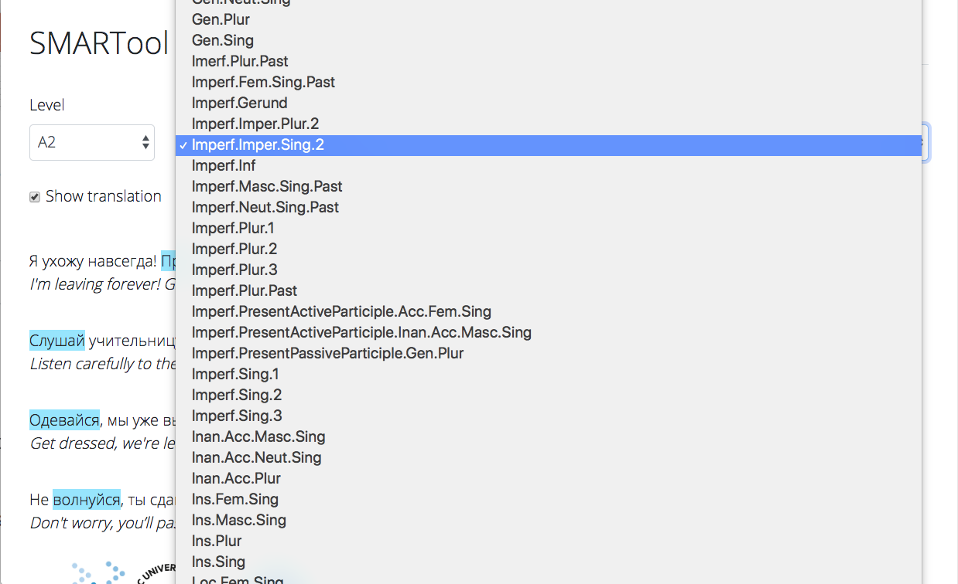

Slide 50
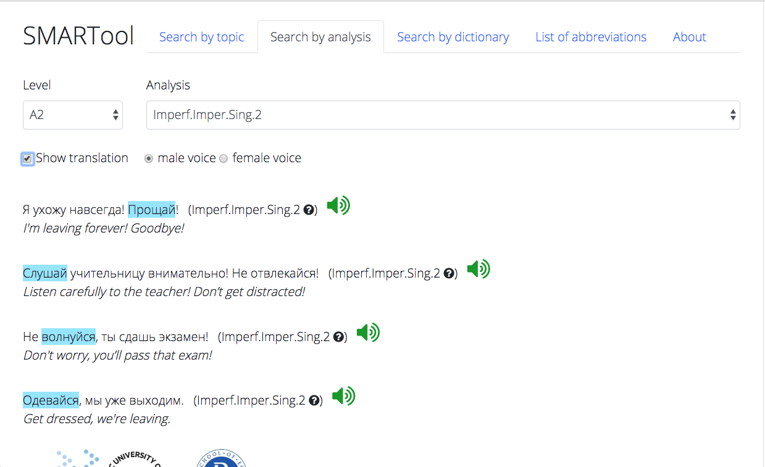

Slide 51
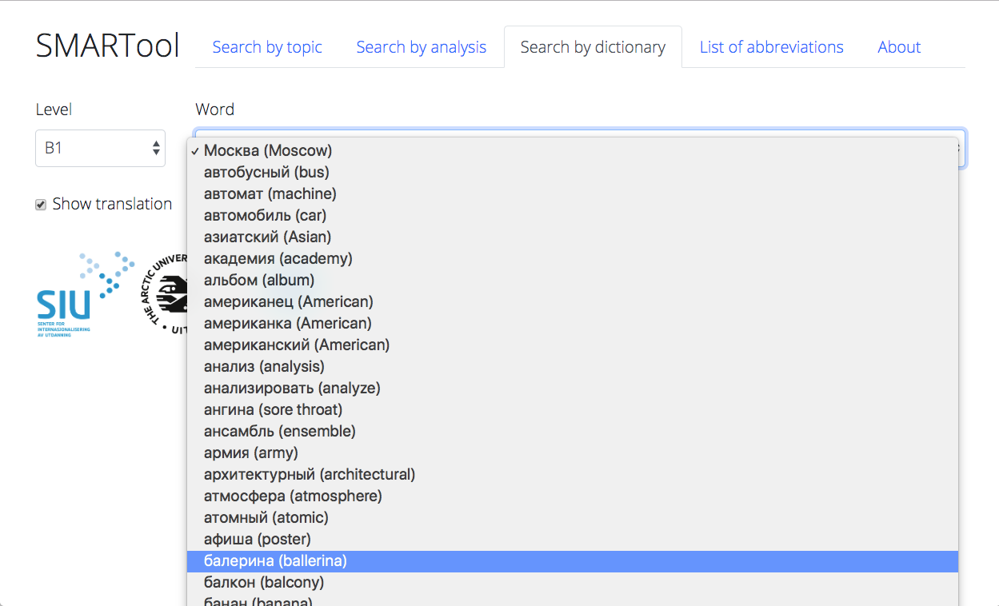

Slide 52
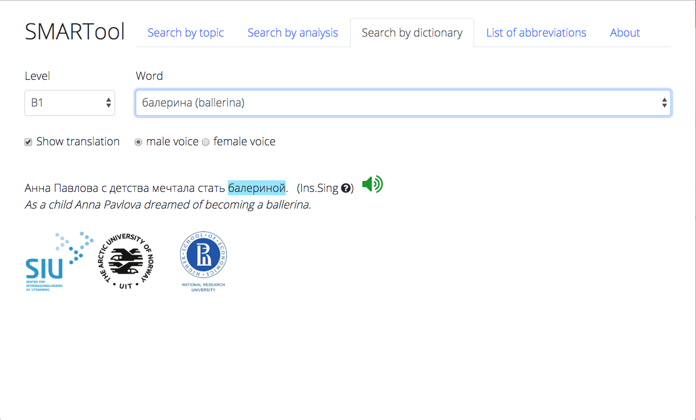

Slide 53
Now for a live demonstration...

Slide 54
The SMARTool:
Inspired by research on the distribution and simulated learning of Russian wordforms (cognitively plausible)
Strategic focus on the highest frequency wordforms and contexts that motivate their use (usage-based)
Reduces the task of learning a basic vocabulary of about 3,000 lexemes by over 90%
Can be continuously updated and custom-tailored
Potentially portable to other languages with rich inflectional morphology

Slide 55
References
Andrjušina, N. P., G. A. Bitextina, L. P. Klobukova, L. N. Norejko, I. V. Odincova (eds.). 2014-2015. Лексический минимум по русскому языку как иностранному. Levels A1-B2. St. Petersburg: Zlatoust.
Baayen, R. Harald. 1992. Quantitative aspects of morphological productivity. In Gert E. Booij and J. Van Marle (eds.), Yearbook of Morphology 1991, 109–149. Dordrecht: Kluwer Academic Publishers.
Baayen, R. Harald. 1993. On frequency, transparency, and productivity. In Gert E. Booij and J. Van Marle (eds.), Yearbook of Morphology 1992, 181–208. Dordrecht: Kluwer Academic Publishers.
Bondar’, N. I. and S. A. Lutin. 2013. Как спросить? Как сказать?, 2nd ed. Moscow: Russkij jazyk.
Černyšov, Stanislav. 2004. Поехали! St. Petersburg: Zlatoust.
Chun, Dorothy, Richard Kern and Bryan Smith. 2016. Technology in language use, language teaching, and language learning. The Modern Language Journal, 100, 64–80. doi:10.1111/modl.12302
Comer, William. 2019. Measured words: Quantifying vocabulary exposure in beginning Russian. Slavic and East European Journal 60, no. 1, 92–114.
deBenedette, Lynne, William J. Comer, Alla Smyslova, Jonathan Perkins. 2013. Между нами (Between You and Me): An Interactive Introduction to Russian. http://www.mezhdunami.org/ (accessed 1 April 2018).
Djačenko, P. V., L. L. Iomdin, A. V. Lazurskij, L. G. Mitjušin, O. Ju. Podlesskaja, V. G. Sizov, T. I. Frolova, L. L. Cinman. 2015. Современное состояние глубоко аннотированного корпуса текстов русского языка (СинТагРус). Сборник «Национальный корпус русского языка: 10 лет проекту». Труды Института русского языка им. В.В. Виноградова. Вып. 6., 272–299.
Endresen, Anna, Laura A. Janda, Robert Reynolds and Francis M. Tyers. 2016. Who needs particles? A challenge to the classification of particles as a part of speech in Russian. Russian Linguistics 40: 2, 103-132. DOI 10.1007/s11185-016-9160-2.
Golonka, Ewa M., Anita R. Bowles, Victor M. Frank, Dorna L. Richardson, Suzanne Freynik. 2014. Technologies for foreign language learning: a review of technology types and their effectiveness. Computer Assisted Language Learning, 27:1, 70–105, DOI: 10.1080/09588221.2012.700315
Hart, Betty and Todd R Risley. 2003. The early catastrophe. The 30 million word gap by age 3. American Educator Spring 2003. 4–9.
Hayes-Harb, Rachel, Jane Hacking. 2015. The influence of written stress marks on native English speakers’ acquisition of Russian lexical stress contrasts. Slavic and East European Journal, 59:1, 91–109.
Hertz, Birgitte, Hanne Leervad, Henrik Lærkes, Henrik Møller, Peter Schousboe. 2001. Свидание в Петербурге. Møde i Petersborg. Copenhagen: Gyldendal.
Janda, Laura A. and Francis M. Tyers. 2018. Less is More: Why All Paradigms are Defective, and Why that is a Good Thing. Corpus Linguistics and Linguistic Theory 14(2), 33pp. doi.org/10.1515/cllt-2018-0031.
Janda, Laura A. Under Submission. Yggur and the power of language: A linguistic invention embedded in a Czech novel.
Kuznetsova, Julia. 2017. The ratio of unique word forms as a measure of creativity. In Anastasia Makarova, Stephen M. Dickey & Dagmar Divjak (eds.), Each Venture a New Beginning: Studies in Honor of Laura A. Janda, 85–97. Bloomington, IN: Slavica Publishers.
Malouf, Robert. 2016. Generating morphological paradigms with a recurrent neural network. San Diego Linguistic Papers. 6. 122–129.
Manning, Christopher D. & Hinrich Schütze. 1999. Foundations of Statistical Natural Language Processing. Cambridge, MA: MIT Press.
Moreno-Sánchez, Isabel, Francesc Font-Clos & Álvaro Corral. 2016. Large-scale analysis of Zipf’s Law in English texts. PLoS One. 11(1). e0147073. 10.1371/journal. pone.0147073.
Robin, Richard, Galina Shatalina, Karen Evans-Romaine. 2012. Голоса (Vols. 1-2), 5th ed. New York: Pearson.
Wade, Terence. 2011. A Comprehensive Russian Grammar, 3rd Edition. Oxford: Wiley-Blackwell.
Zaliznjak, A. A. 1980. Грамматический словарь русского языка. Moscow: Russkij jazyk.
Zipf, George K. 1949. Human Behavior and the Principle of Least Effort. Reading, MA: Addison-Wesley.

